Slide 1


FarmHome
Tran Dang Khoa -19110145
Pham Viet Anh – 19110151
Nguyen Le Minh Nhut - 19110100

Slide 2

FarmHome
Technology
Angular
React Native
Tran Dang Khoa -19110145
Pham Viet Anh – 19110151
Nguyen Le Minh Nhut - 19110100
Spring Boot
Tensorflow

Slide 3
Farmer
Technology
Login
Add New Product
Edit Product
Delete Product
Dealing Order
Confirm Order
Detect Product
Angular
React Native
Spring Boot
Tensorflow

Slide 4
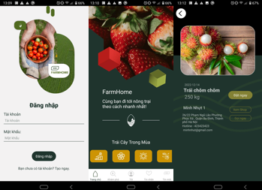
Technology
Merchant
Farmer
Login
Sign up
Edit Information
Change password
Find product
Create order
Delete order
Confirm dealing
View history
Change language
Login
Add New Product
Edit Product
Delete Product
Dealing Order
Confirm Order
Detect Product
Angular
React Native
Spring Boot
Tensorflow

Slide 5
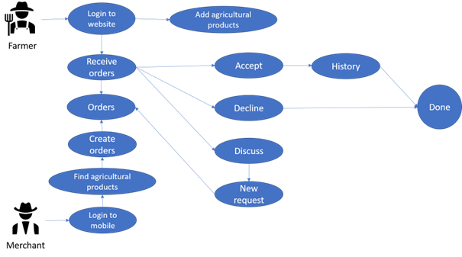
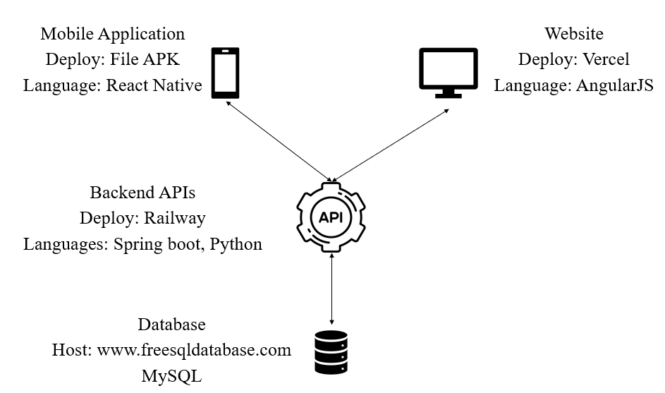
Farmer
Merchant
Login
Sign up
Edit Information
Change password
Find product
Create order
Delete order
Confirm dealing
View history
Change language
Login
Add New Product
Edit Product
Delete Product
Dealing Order
Confirm Order
Detect Product

Slide 6

FarmHome
Merchant
Login
Sign up
Edit Information
Change password
Find product
Create order
Delete order
Confirm dealing
View history
Change language
Advantages:
Fully handled ordering process, ensuring fairness for farmers
The user interface is guided enthusiastically by the instructors
Database, applications are uploaded on the internet
Intergrate a detection model that can be used for classifying
Disadvantage:
Some of the feature are still not completed.
The Machine learning model is used only for classify several agriculturals, some new products can be misclassified.
For some specific area, this app will not really being applied for the actual situation.

Slide 7
FarmHome
Merchant
Login
Sign up
Edit Information
Change password
Find product
Create order
Delete order
Confirm dealing
View history
Change language
Advantages:
Fully handled ordering process, ensuring fairness for farmers
The user interface is guided enthusiastically by the instructors
Database, applications are uploaded on the internet
Intergrate a detection model that can be used for classifying
Disadvantage:
Some of the feature are still not completed.
The Machine learning model is used only for classify several agriculturals, some new products can be misclassified.
For some specific area, this app will not really being applied for the actual situation.

Slide 8

FarmHome
Future developments
Advantages:
Add new features to support the dealing prices between the merchants and the farmers to make sure the price will be satisfied between the two.
Fully handled ordering process, ensuring fairness for farmers
The user interface is guided enthusiastically by the instructors
Database, applications are uploaded on the internet
Intergrate a detection model that can be used for classifying
Research for some specific areas that are not modern to have some plans or solution to make it easy and convenient for people at there places.
Disadvantage:
Some of the feature are still not completed.
The Machine learning model is used only for classify several agriculturals, some new products can be misclassified.
Add more models for classifying more type of products
For some specific area, this app will not really being applied for the actual situation.

Slide 9
FarmHome
Future developments
Advantages:
Add new features to support the dealing prices between the merchants and the farmers to make sure the price will be satisfied between the two.
Fully handled ordering process, ensuring fairness for farmers
The user interface is guided enthusiastically by the instructors
Database, applications are uploaded on the internet
Intergrate a detection model that can be used for classifying
Research for some specific areas that are not modern to have some plans or solution to make it easy and convenient for people at there places.
Disadvantage:
Some of the feature are still not completed.
The Machine learning model is used only for classify several agriculturals, some new products can be misclassified.
Add more models for classifying more type of products
For some specific area, this app will not really being applied for the actual situation.

